Slide 1

Making methane and its health impacts actionable
Team Climate Coders
Wellcome Data Science Ideathon | 2023

Slide 2



Action is needed to protect population health from the effects of methane
Methane has accounted for ~30% of global warming
Emissions are caused by coal, gas, oil, agriculture, and livestock
Contributor to the formation of ground-level ozone, a hazardous air pollutant, exposure to which causes 1 million premature deaths every year
Satellites have enabled better monitoring of methane emissions and leaks
Notes:
Source: https://www.unep.org/news-and-stories/story/methane-emissions-are-driving-climate-change-heres-how-reduce-them

Slide 3

Action is needed to protect population health from the effects of methane
Methane has accounted for ~30% of global warming
Policymakers and health officials need help to process and analyze data and use it effectively for response and action
Emissions are caused by coal, gas, oil, agriculture, and livestock
Contributor to the formation of ground-level ozone, a hazardous air pollutant, exposure to which causes 1 million premature deaths every year
Satellites have enabled better monitoring of methane emissions and leaks
Notes:
Source: https://www.unep.org/news-and-stories/story/methane-emissions-are-driving-climate-change-heres-how-reduce-them

Slide 4
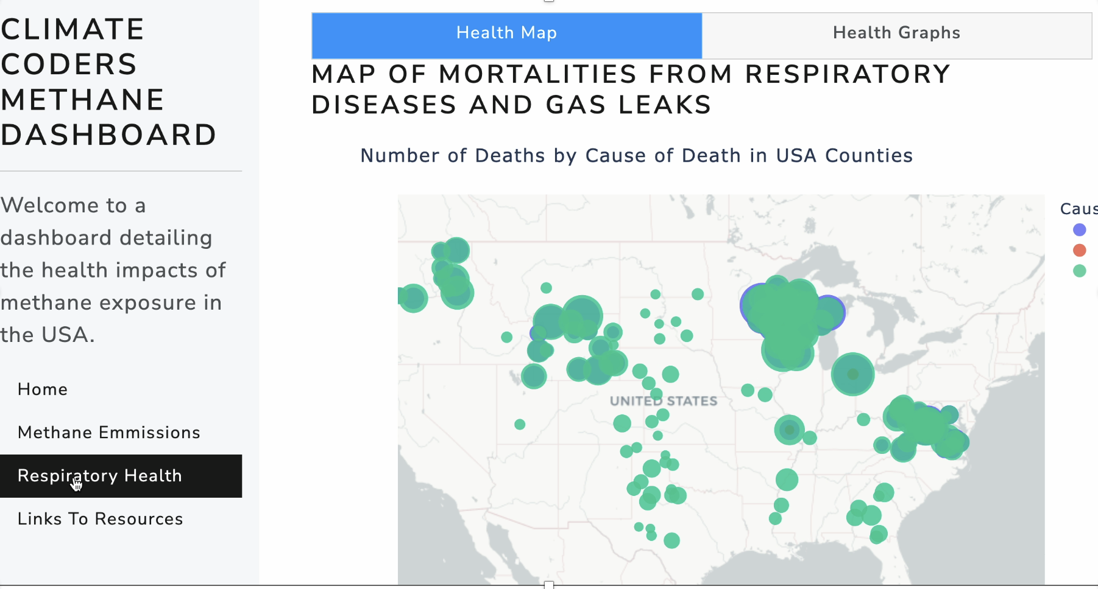



A dashboard to make methane and health data actionable for decision makers
Visualize impacts for advocacy and policymaking
Respond to public health emergencies
Customize by adding your own data
Notes:
Source: https://www.unep.org/news-and-stories/story/methane-emissions-are-driving-climate-change-heres-how-reduce-them

Slide 5

User journey for our county level environmental policy officer CLAIRE
Visualize
Respond
Customize
Recording that shows how claire looks at the platform and finds stuff that helps her visualize, respond, and customize

Slide 6
Q1: How has your platform presented complex relationships?
Simplicity and clear take aways for figures
Interactivity to let users explore and add complexity as desired
Actionable through action plans that connect data to the next steps
Connection between disjunct data to enable public health action
Notes:
Source: https://www.unep.org/news-and-stories/story/methane-emissions-are-driving-climate-change-heres-how-reduce-them

Slide 7
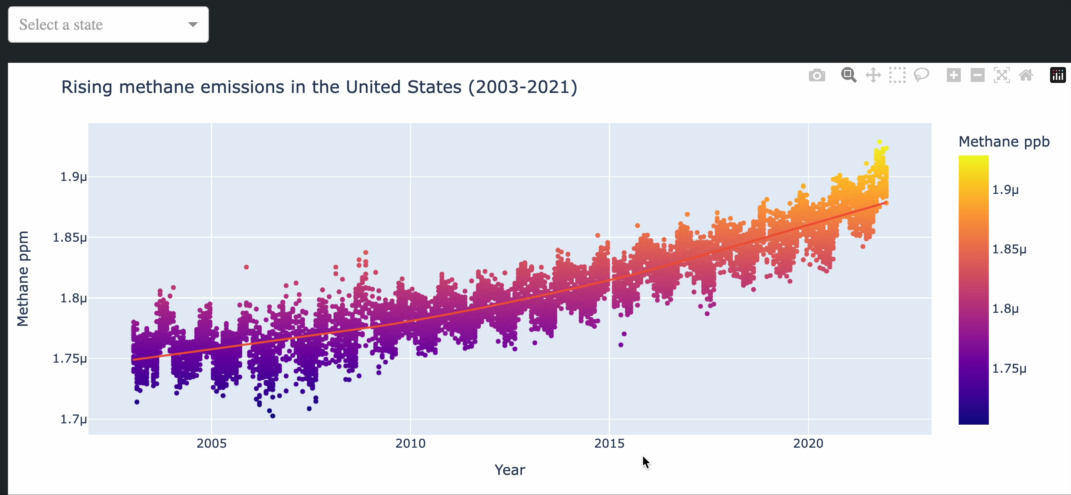

Simplicity and clear take aways for figures
Interactivity to let users explore and add complexity as desired

Slide 8
We want a screenrecording of Ben’s leaks and hospitals plot
Actionable through action plans that connect data to the next steps
Connection between disjunct data to enable public health action
Notes:
Source: https://www.unep.org/news-and-stories/story/methane-emissions-are-driving-climate-change-heres-how-reduce-them

Slide 9
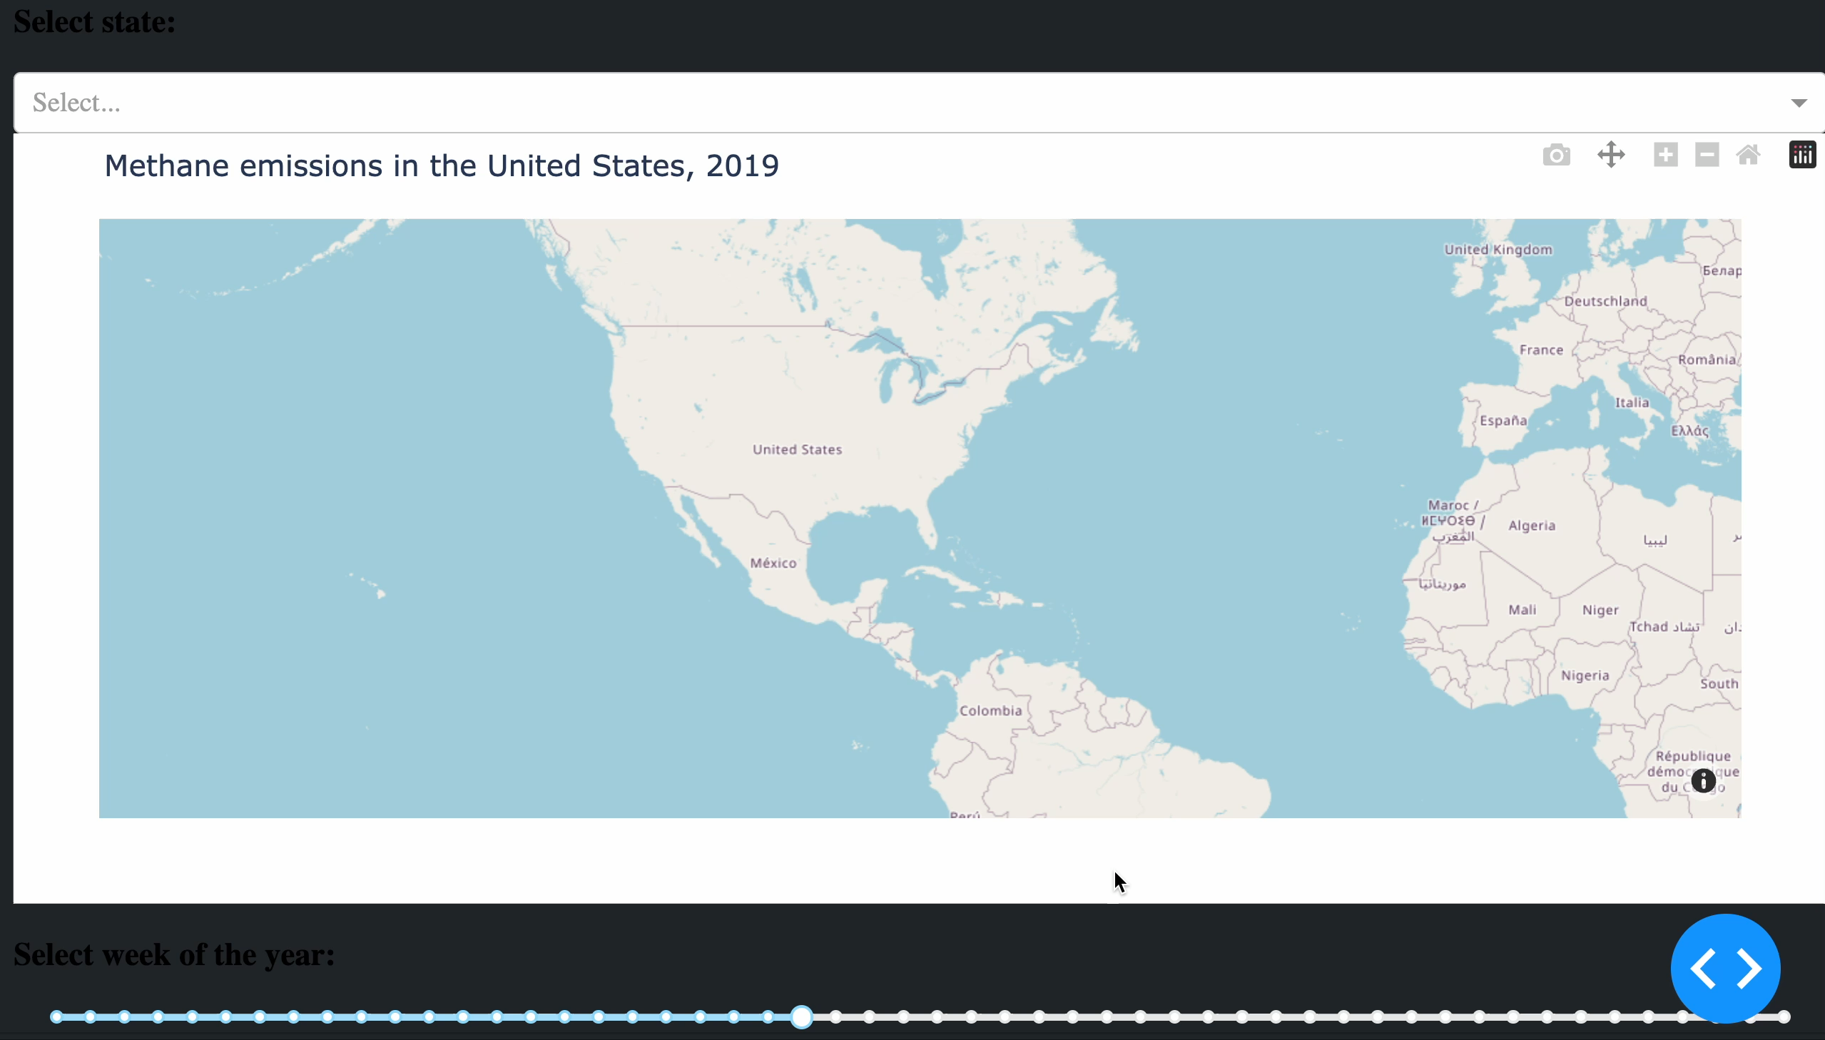
Q2: How do you ensure your platform is accessible, usable, and sustainable and that data can be shared safely and well credited?
Interactive
Intuitive exploration
Different regional levels
Reproducible
Publicly available
Links to further resources
User-centric
Color-blind friendly
Interview officials

Slide 10
Q2: How do you ensure your platform is accessible, usable, and sustainable and that data can be shared safely and well credited?
Interactive
Intuitive exploration
Different regional levels
Screenshot of further resources?
Ask group if we need this slide and next slide?
Reproducible
Publicly available
Links to further resources
User-centric
Color-blind friendly
Interview officials

Slide 11
Q2: How do you ensure your platform is accessible, usable, and sustainable and that data can be shared safely and well credited?
Interactive
Intuitive exploration
Different regional levels
Ask group?
Reproducible
Publicly available
Links to further resources
User-centric
Color-blind friendly
Interview officials

Slide 12
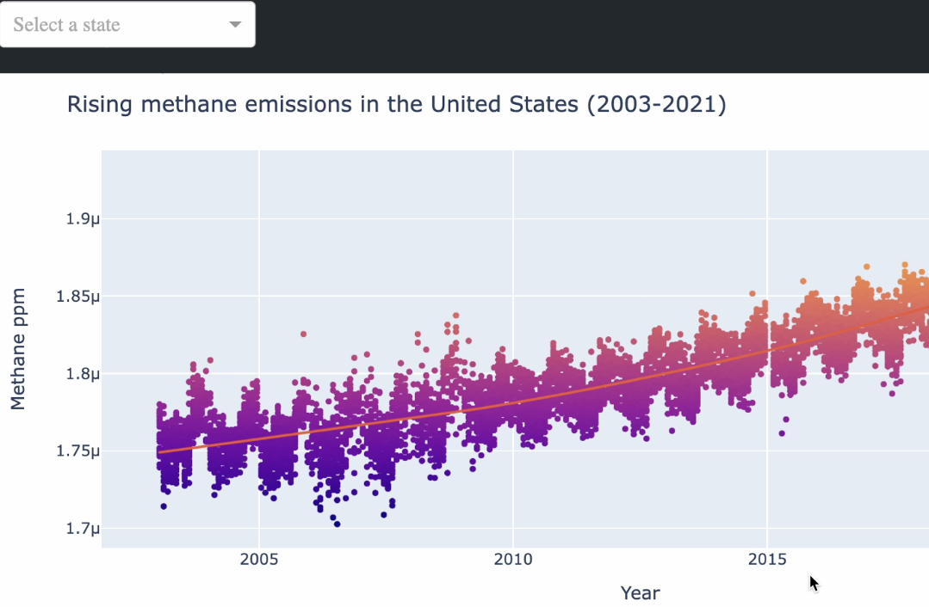
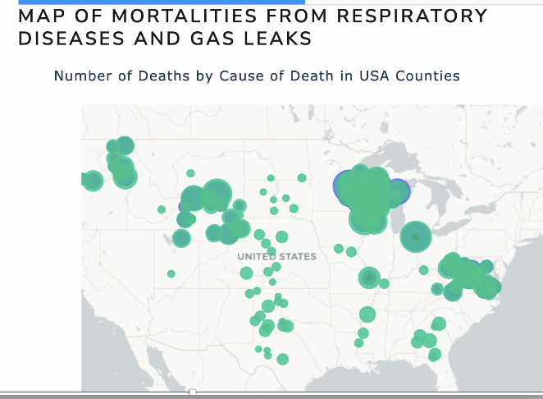
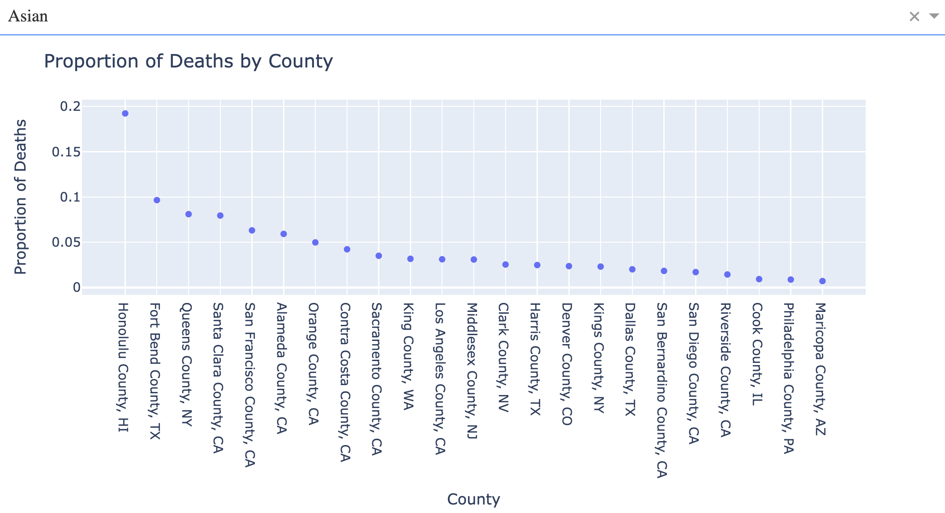
Q3: How will your platform integrate datasets with different time and geographical scales?
Plots
Data
Visualize data at county, state, and national level
Download data on methane with
Longitude + latitude
County level averages
State level averages

Slide 13

Vision | Help users geotag their data
Build automated API requests for locations
Collaborate with the data pipeline team
Hear from you to improve our platform

Slide 14
Embed an inclusive approach: equitable, diverse, inclusive How you do things -> methodologies How do you ensure that people are participating Are you capturing lived experience: call for partnerships Not looking at who you are, but more how you set up the team; good prezzie vibes You work reciprocal Be very practical: there are a lot of pointers in the application around environment: e.g., how do you promote other people and look after other people in a team. How are you working to develop yourself as a leader. How can an institution help you with that? Ask a sponsor to support you
EDI Advice

Slide 15
Thank you.
Team Climate Coders.

Slide 16
Our rough outline: Why do we care? Motivate the topic What is the challenge? Help Policymakers and health officials How are we solving it? Dashboard -> deep dives Three specific questions -> perhaps connect with deep dives?
Slide to organize our thinking
Advice from Wellcome
Your first presentation will be to a (closed, i.e. no one else can watch) panel of approx 6 people and should be 15mins and there will be no Q&A. Finalist presentations will be 10mins + 5min Q&A from the panel and other participants via Slido who will be able to watch. You’re not expected to create a different second presentation but we’d suggest that your second presentation focus more on novelty/innovation and you don’t need to talk about the background to the challenge — again there will be a lot of time to chat about this next Tues and Wed.
Question 1: How has your platform presented complex methane and health data (and their relationship) in a way that can be understood by key stakeholders but without ‘dumbing down’ the information?
Question 2: How would you ensure your platform is accessible, usable, and sustainable and that data can be shared safely and well credited?
Question 3: How will your platform integrate datasets with different time and geographical scales?

